Slide 1

Project - Phase 1
Global Disaster Atlas: Visualizing Hazards and Their Impact Worldwide (2000-Present):
Team Members (Name with Roll.No.):
Avinash Tiwari (22BDS010)
Ayush Singh (22BDS012)
Nachiket Ganesh Apte (22BDS041)
Github Repo Link: https://github.com/nachiketapte1404/data_visualization_course_project.git

Slide 2
Overview of the Project
Dataset / Feature description :
Features : Disaster Subgroup,Disaster Type,Disaster Subtype,Country,Subregion,Region,Location,OFDA/BHA Response,Appeal,Declaration,AID Contribution ('000 US$),Magnitude,Magnitude Scale,River Basin,Total Deaths,No. Injured,No. Affected,No. Homeless,Total Affected,Reconstruction Costs ('000 US$),"Reconstruction Costs, Adjusted ('000 US$)",Insured Damage ('000 US$),"Insured Damage, Adjusted ('000 US$)",Total Damage ('000 US$),"Total Damage, Adjusted ('000 US$)",CPI,Start_Date,End_Date,Duration
Project’s Scope/ Deliverables : To understand behavioural pattern of disasters, problems related to relocation, reconstruction, etc. There is no such dashboard present currently
Tools and Technologies used (till now) : Plotly, Matplotlib, Seaborn

Slide 3
Progress Achieved (Phase 1)
About 35 % of the work has been done. This includes data preprocessing and plotting static graphs with the plan to convert them into dynamic graphs. This is a part of exploratory data analysis.
We faced many challenges when cleaning the dataset. The first was the number of missing values. Since it was a raw dataset, the authors entered data only when they had accurate information and when the concerned authorities released the data. So, we had to either omit the rows if the column was a crucial one or remove the column entirely

Slide 4
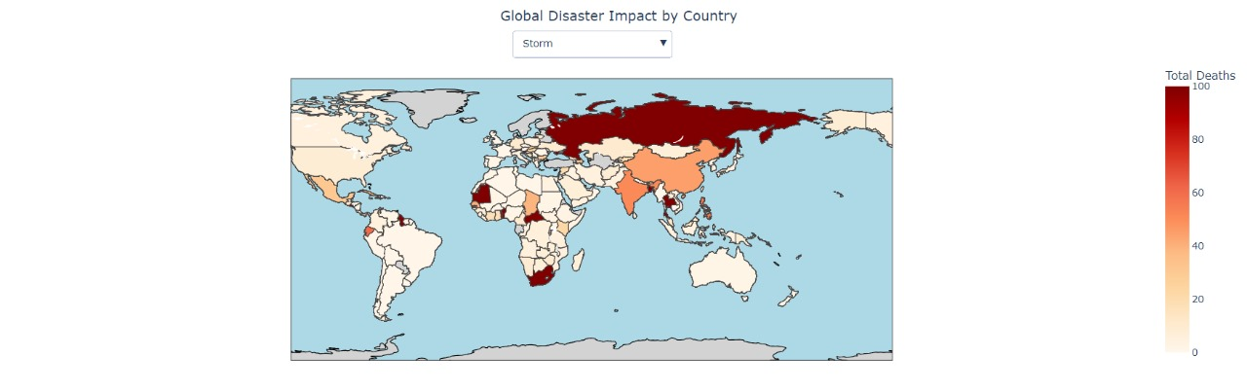
A sample of the dynamic heatmap for disaster

Slide 5
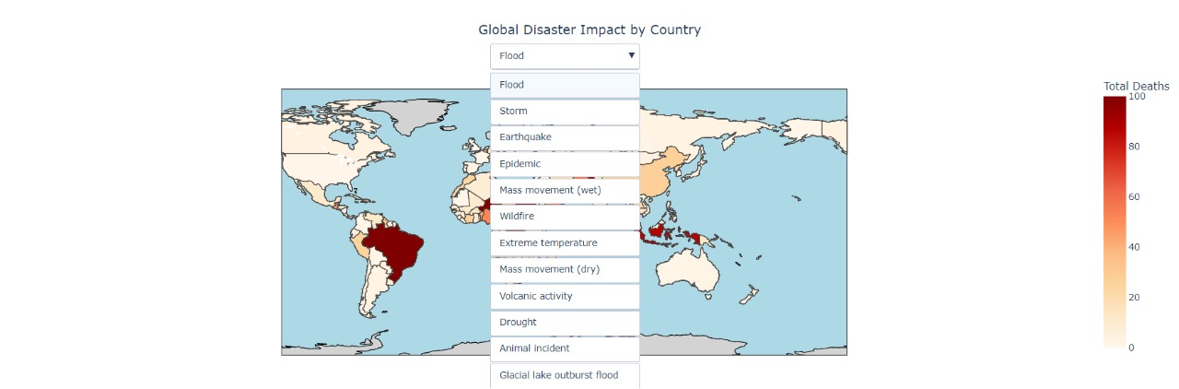
Drop down functionality for various disasters

Slide 6
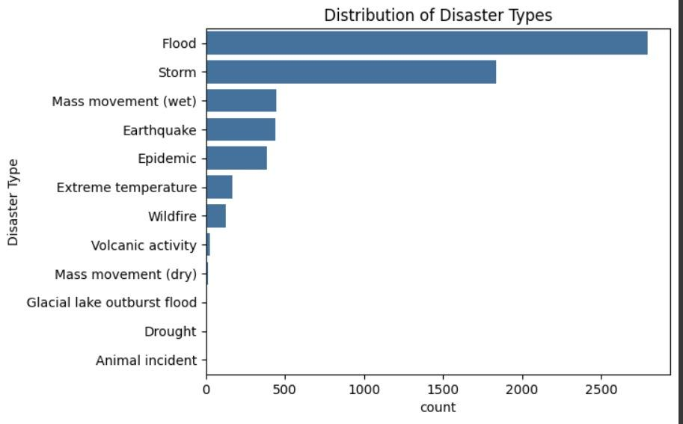

Slide 7
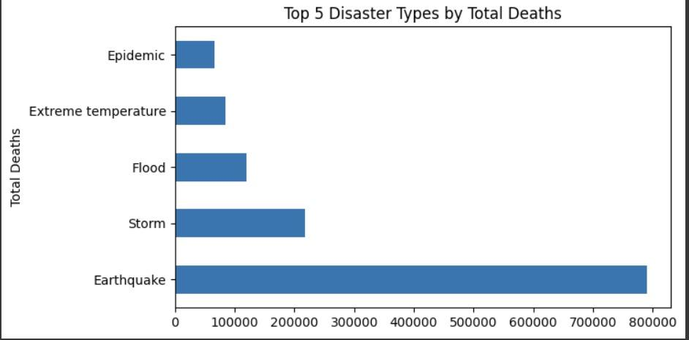

Slide 8
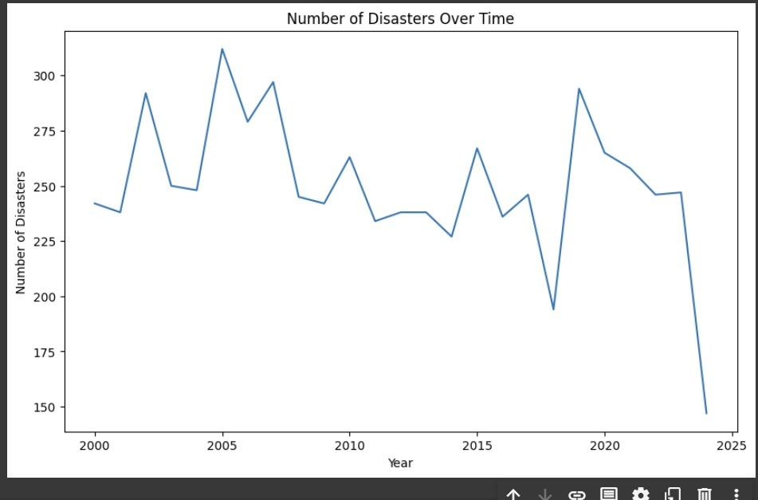

Slide 9
Plan for Next Phase
Enable dynamic selection of countries and displaying the disaster heatmap in the selected country
Also to add the metadata like Total deaths, total injured for a particular disaster in a particular country.
Timeline - October end - 2nd phase completion (aka Project completion)

Slide 10
Conclusion / References
A brief summary of the project’s progress and its significance.
List any resources, tools, or references used during this phase.
Gave hints about upcoming project work and the course of action.

Slide 11
Thank You !!!

